Slide 1

BMGT 221 WEEK 1
BUSSINESS COMMUNICATION

Slide 2
Business communication
From a basic concept, communication is the process of sending and receiving messages or transferring information from one part (sender) to another (receiver).
By definition, business communication, is relaying of information within a business by its people..that is within and outside the organization for commercial benefits.
Second definition is Business communication is , “Flow of information and perception. either within a business organization or outside the organization among different
parties”.
a good example is how a company shares information (advertise)to promote its product or services to potential consumers
It entails how employees, management and administration communicate in order to reach to their organizational set goals.

Slide 3
Business communication process
According to Mr. Kreitner, Business Communication process is a chain made up of identifiable links. This links includes sender, message, encoding, receiver, decoding and feedback.”
According to S.K. Kapur, “The Communication process is the method by which the sender transfers information and understanding to the receiver.”
Communication is always made with some purpose. This purpose of communication under BUSSINESS COMMUNICATION, purely for business purpose.

Slide 4
Purpose of Business communication
Roles played by business communication includes:
Setting goals and Objectives.
Making and Implementing decision
Interaction between employer & employee
Dealing with customers:
Hiring the employees.
Negotiating with suppliers and financiers
Interacting with Govt.
Informing the investors
Sharing business ideas.
Sharing proposals
Sharing of information and facts.
Reports.

Slide 5
Business Communication process
Business communication by defination is a process. Every communication process has what it intends at achieving communication is a two-way-process of exchanging ideas and information between human beings
Business communication process is comprised of five factors that is:
    the sender/source,
    the message,
    channel.
    receiver/destination
    feedback.

Slide 6
Business Communication process
The sender’s thought-the first step is generation of thoughts in a senders mind that ought to be communicated in understandable manner.
Message and Encoding-unless sender’s thought are communicated and hence the need to convert ones, thought in to a message via an understandable language.
Transmission-once senders thought has been converted into a message, the message needs to travel via a medium in order to reach the intended audience example is an advert via newspaper, others include email,T.v Radio and air

Slide 7
Communication process.
Decoding-once the receiver gets the message,he/she attempts to derive some meaning out it. The method of converting back the message communicated to thoughts in the mind od receiver is called decoding.
Idea received-once decoding is complete idea being communicated by the sender is already received by the receiver.
Noise is a factor that cannot be factored out. During decoding, lack of concentration, poor language, emotions, poor reading abilities and poor transmission may prevent proper decoding of the sent message resulting in loss of intended message.

Slide 8
Purpose of business communication continuation…
To express one's thoughts better so as to be understood better amongst colleagues
To create a positive rapport among colleagues and seniors that imparts a good impression.
To communicate better with subordinates which helps to motivate and guide them and extract maximum output.
To maintain a good relations with suppliers, vendors, financiers and other organizations
To reach out to the customers effectively for huge customer base.

Slide 9
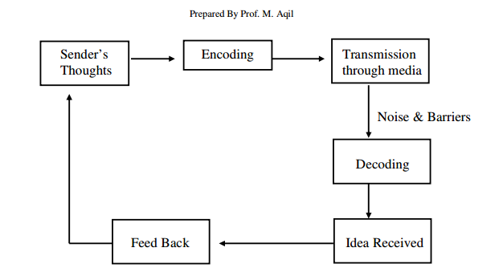
Communication process demonstration

Slide 10
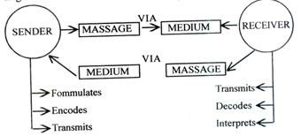

Slide 11
Barriers to communication
Language difference.
Use of jargon terms
Difference in perception and view points physical disabilities such as visual or hearing related.
Distraction.
lack of attention due to irrelevance of the message to receiver.
Psychological state of the communicator.
Attitudinal barriers such as resistance to change. Adverts try to overcome the attitudes of potential customers.

Slide 12
assignment
Classify the communication barriers under business environment and state how they can affect communication.
discuss roles played by communication in a business environment citing relevant examples.
What are the goals of business communication

